Slide 1


Overview of CE-QUAL-W2 Version 4.5
UNCLASSIFIED
Zhonglong Zhang, PhD, PE, PH
Portland State University
CE-QUAL-W2 Workshop
August 16 - 18, 2022
Environmental Systems
Modeling Team
UNCLASSIFIED

Slide 2
Outline
W2 version 4.5 inputs/outputs
Water quality kinetics
State variables
Derived variables
WQ processes
TDG/SYSTDG
Bed sediment
V4.5 tools

Slide 3
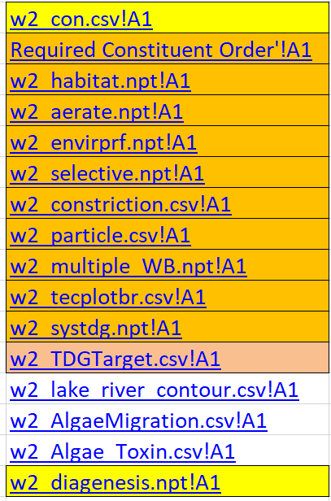
CE-QUAL-W2 V4.5 Inputs
Control file changes
csv format
Excel template to support develop input control files
Excel file w2_con.xlsm → w2_con.csv
Time series file changes - csv format
Atmospheric deposition inputs of WQ state variables
Atmospheric CO2 input changes
Oxygen reaeration

Slide 4
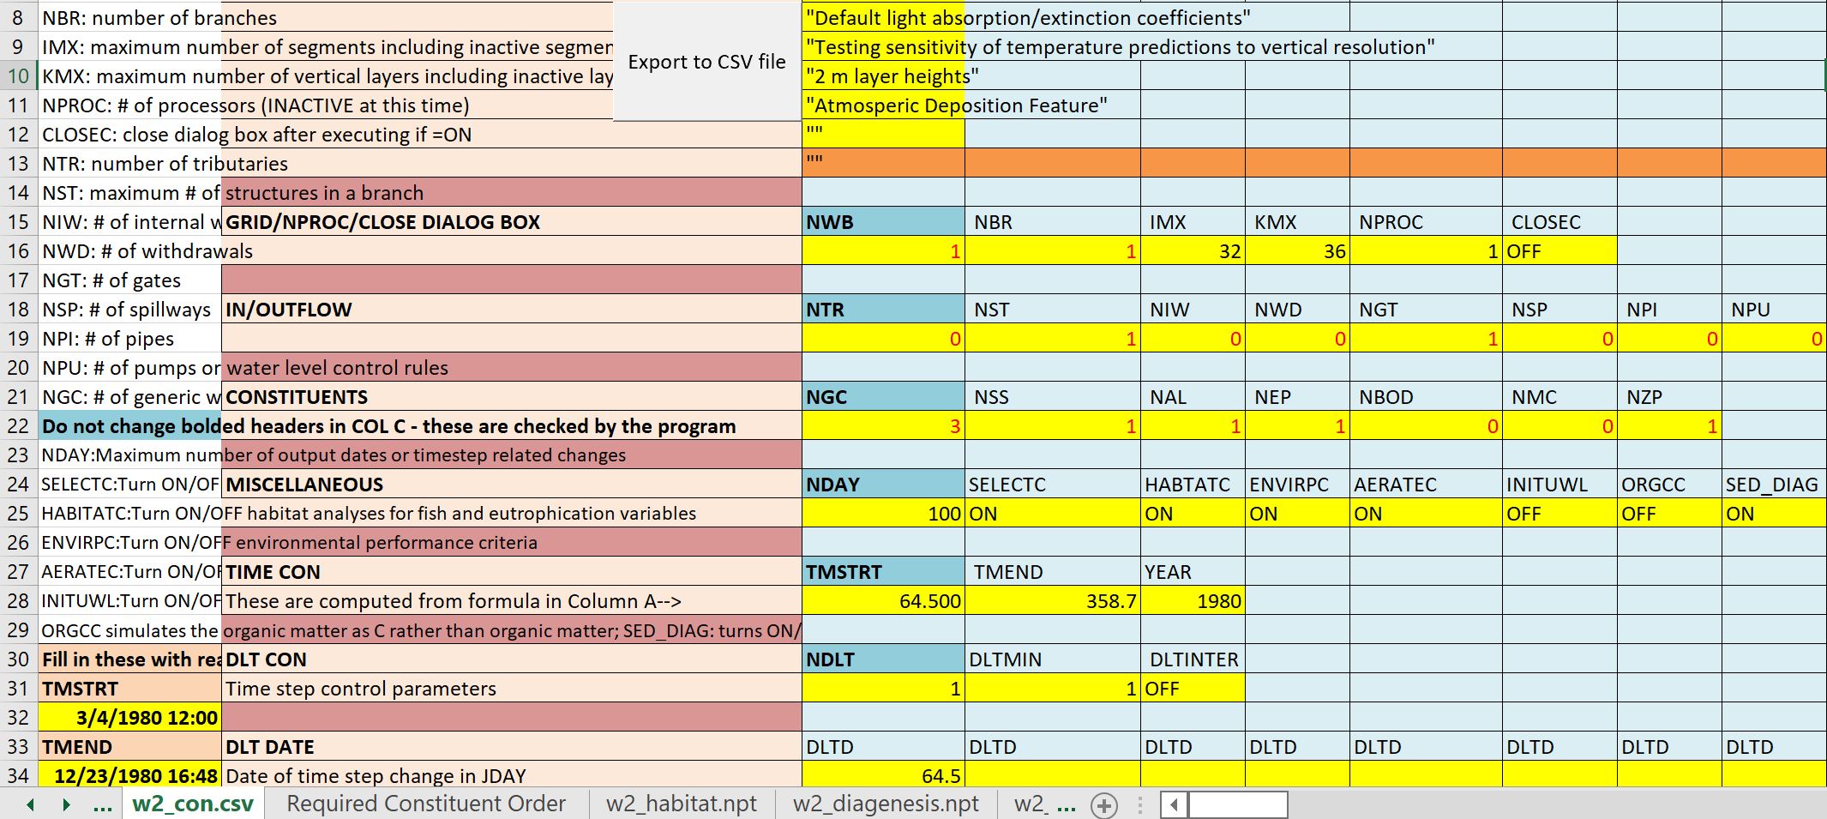
CE-QUAL-W2 Control File: w2_con.xlsm

Slide 5
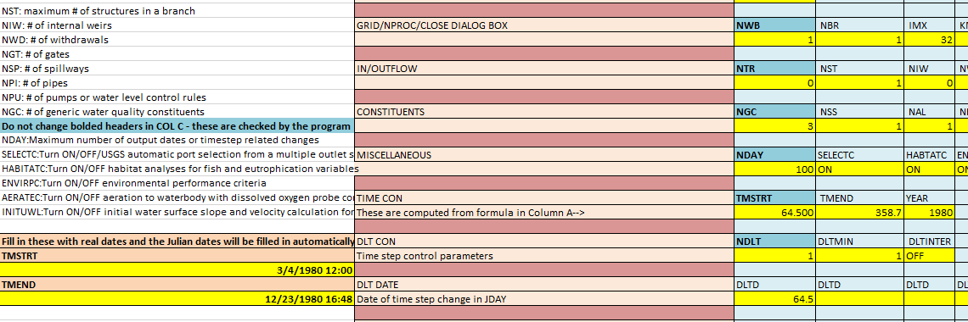
CE-QUAL-W2 Control File: w2_con.xlsm

Slide 6
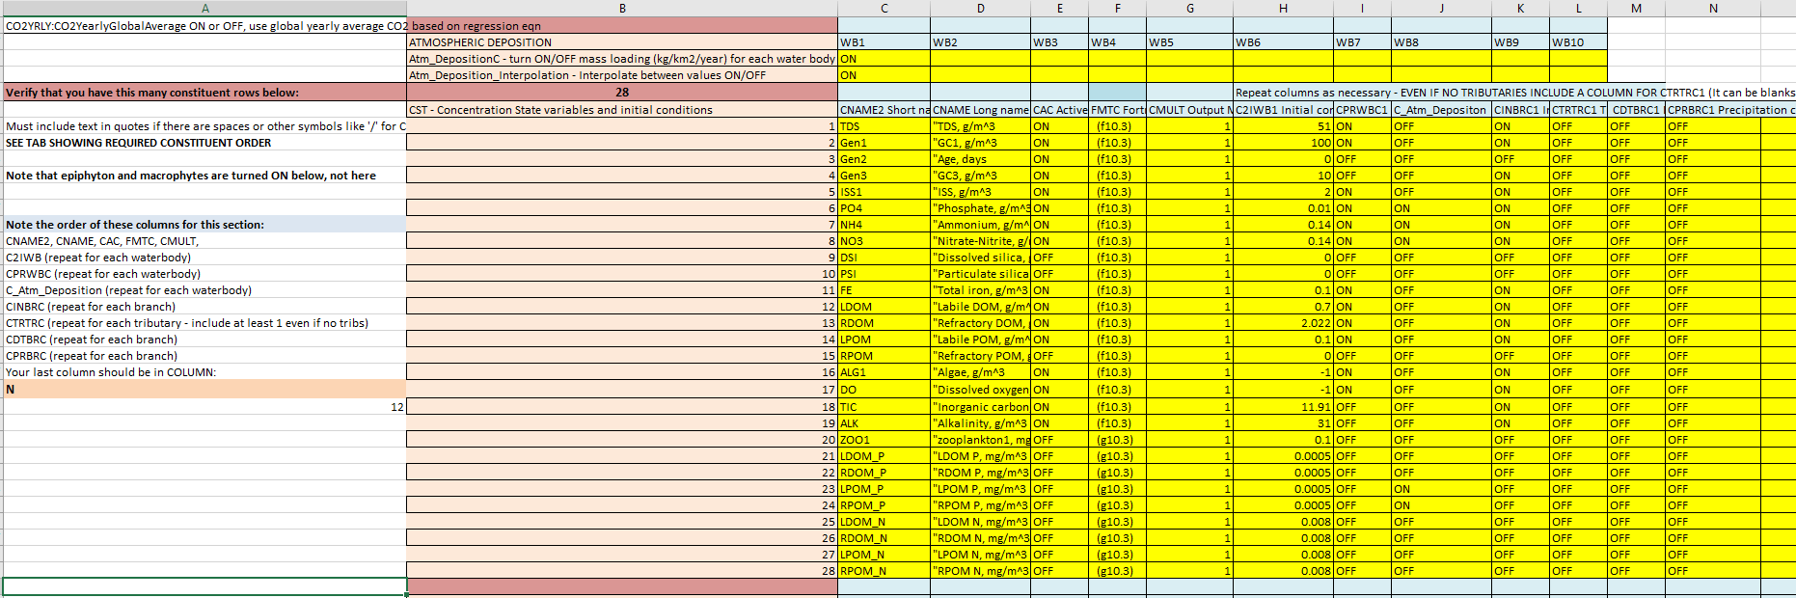
CE-QUAL-W2 Control File: w2_con.xlsm

Slide 7
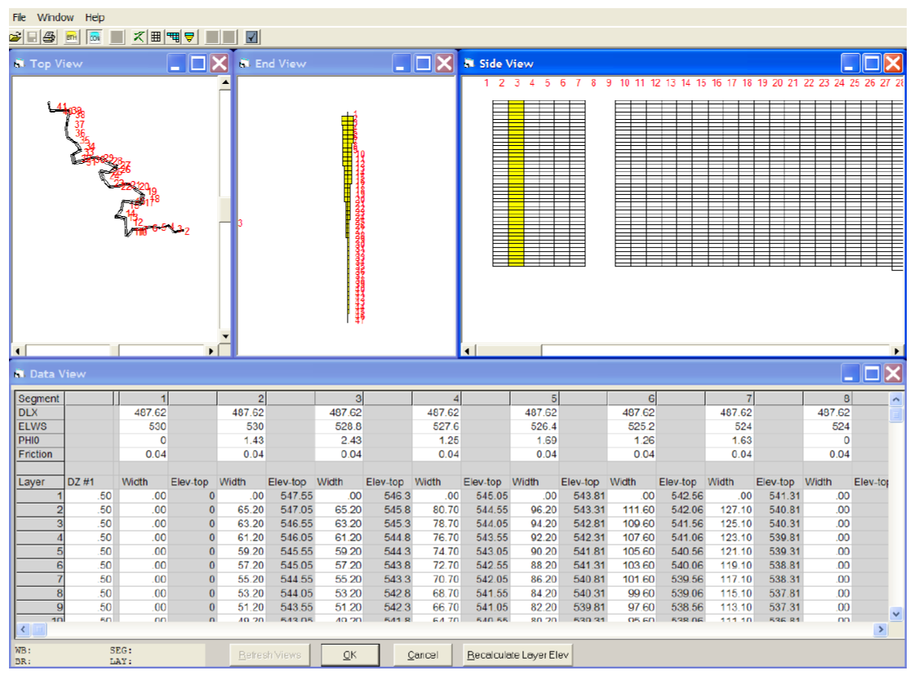
CE-QUAL-W2 Control File: w2_con.xlsm
Advantages
Simplified editing
No graph.npt
Easier for cutting and pasting
Simplified I/O
Files are better organized
Variable names and explanations at your fingertips
Formulae are used to assist in control file development
Disadvantages
Macro – Security
W2 GUI Interface (W2_Control) for Versions 3.7-4.2 is broken

Slide 8
Atmospheric Deposition Inputs of WQ State Variables
Atmospheric deposition: either dry or wet deposition (rain or snow) of pollutants contribute to the mass loading of a pollutant.
Dry deposition can include dust or particle transport associated with the pollutant.
The processes of atmospheric deposition include any state variables in W2.
$atm_deposition_wb1.csv
Atmospheric mass input, kg/km2/year
JDAY | PO4 | NH4 | NO3 | LPOMP | RPOMP
1 | 14 | 0.6 | 2 | 1 | 1
100 | 16 | 0.7 | 2 | 1 | 1
250 | 18 | 0.6 | 2 | 1 | 1
365 | 14 | 0.7 | 2 | 1 | 1
400 | 14 | 0.6 | 2 | 1 | 1

Slide 9
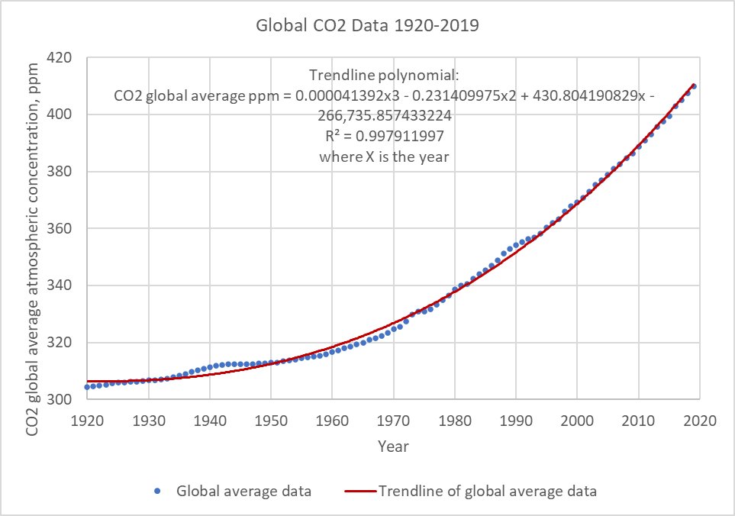
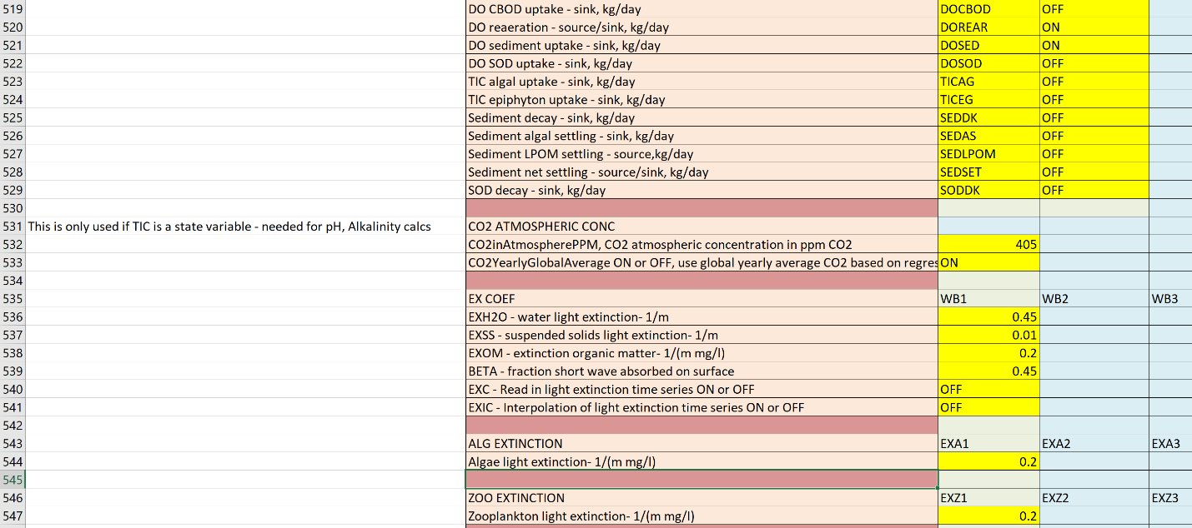
Atmospheric CO2 Input Changes

Slide 10
Additional Outputs
Mass balance of TN and TP
Water body fluxes of 72 pathways
Selective withdrawal outputs in snapshot (*.snp) file
Contour plots
Ability to generate lake contours easily (elevation vs time for temperature and DO)
Ability to generate river contours easily (model segment or distance along river vs time for temperature and DO)

Slide 11
Water Quality Kinetics
State variables
New state variables: Water age, Bacteria, DGP, N2, H2S, CH4, SO4, Fe species (FEII, FEOOH), Mn species (MnII, MnO2)
Directly simulates organic carbon constituents (LDOC, RDOC, LPOC, RPOC)
Algae toxins
New derived variables: Turbidity, Secchi disk, TDG, NH3
Sediment Diagenesis updates: control file, computation efficiency
Vertical migration of zooplankton and cyanobacteria

Slide 12
Water Quality Kinetics
General Constituents
Bacteria
CBOD
DGP, N2
TDG
Algae toxins
H2S, CH4, SO4, Fe(II), FeOOH, Mn(II), MnO2
Organic Carbon
Zero order
First order
Sediment diagenesis

Slide 13
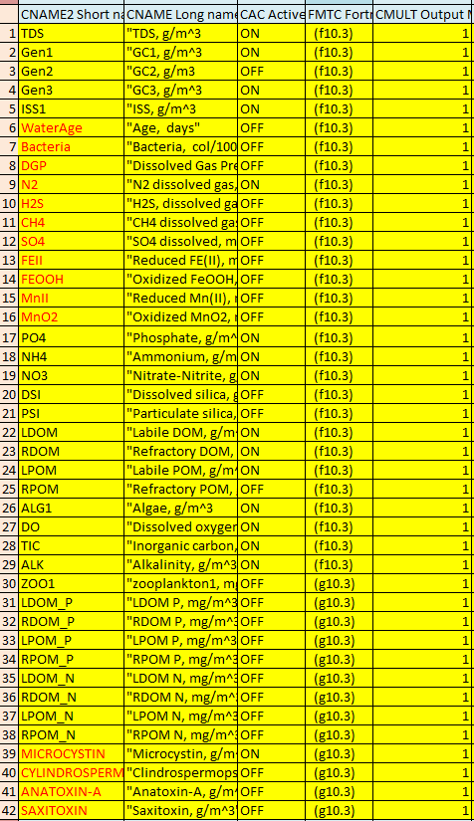
Water Quality State Variables
TDS
Gen1
Gen2
ISS1
ISS2
WaterAge
Bacteria
DGP
N2
H2S
CH4
SO4
Fe (II)
FeOOH
Mn (II)
MnO2
PO4
NH4
NO3
DSI
PSI
LDOM (LDOC)
RDOM (RDOC)
LPOM (LPOC)
RPOM (RPOC)
CBOD1
CBODP1
CBODN1
ALG1
ALG2
DO
TIC
ALK
LDOM-P
RDOM-P
LPOM-P
RPOM-P
LDOM-N
RDOM-N
LPOM-N
RPOM-N
MICROSYSTIN
CYLINDROSPERMOPSIN
ANATOXIN-A
SAXITOXIN

Slide 14
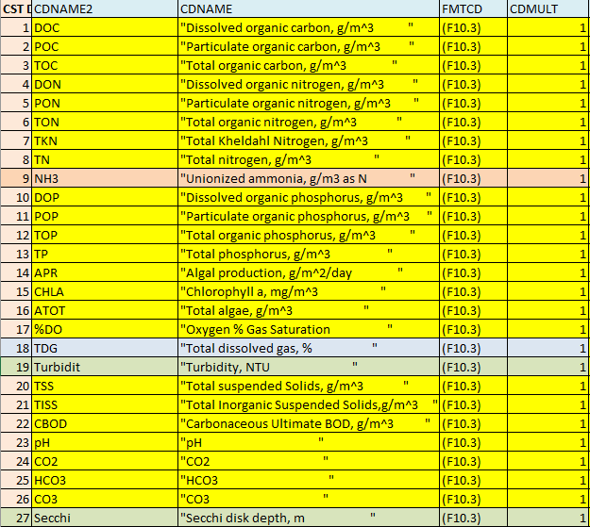
Water Quality: Derived Variables
DOC
POC
TOC
DON
PON
TON
TKN
TN
NH3
DOP
POP
TOP
TP
APR
CHLA
ATOT
%DO
TDG
Turbidity
TSS
TISS
CBOD
pH
CO2
HCO3
CO3
SECCHI

Slide 15
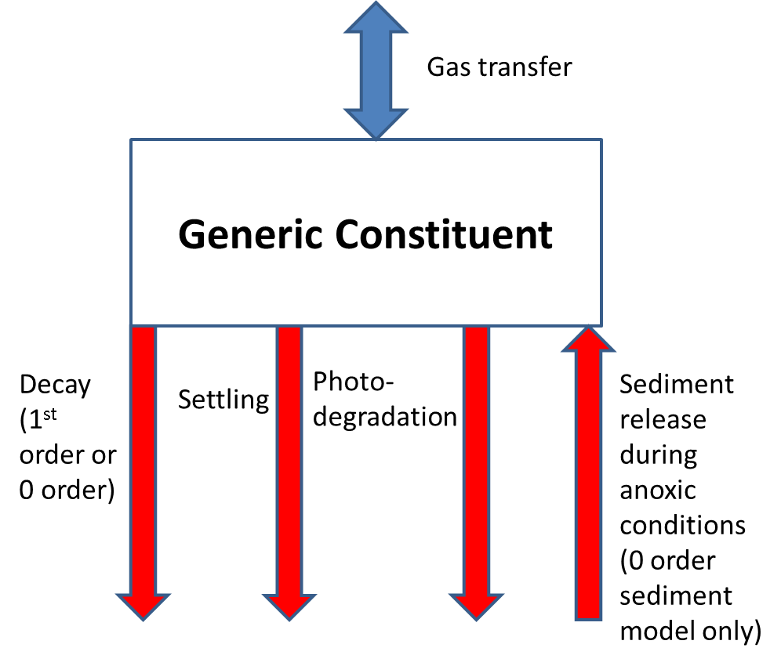
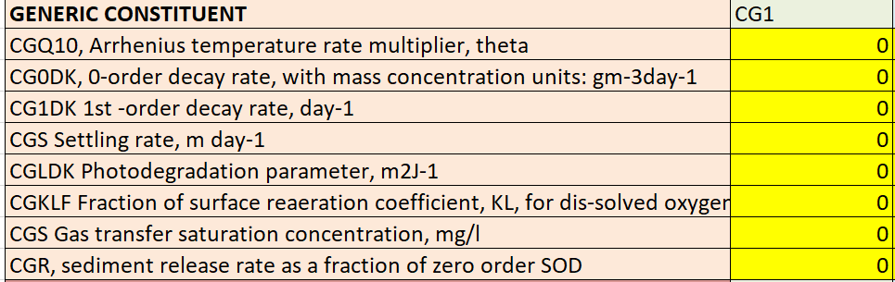
Water Quality: Generic Constituents
$$S_{g}=−K_{0}θ^{\left(T−20\right)}−K_{1}θ^{\left(T−20\right)}Φ_{g}−ω_{g}\frac{∂Φ_{g}}{∂z}−αI_{o}\left(1−β\right)e^{−λz}Φ_{g}+\frac{A_{sur}}{V_{sur}}K_{L}\left(Φ_{s}−Φ_{g}\right)+K_{sedrel}SOD\frac{A}{V}$$

Slide 16
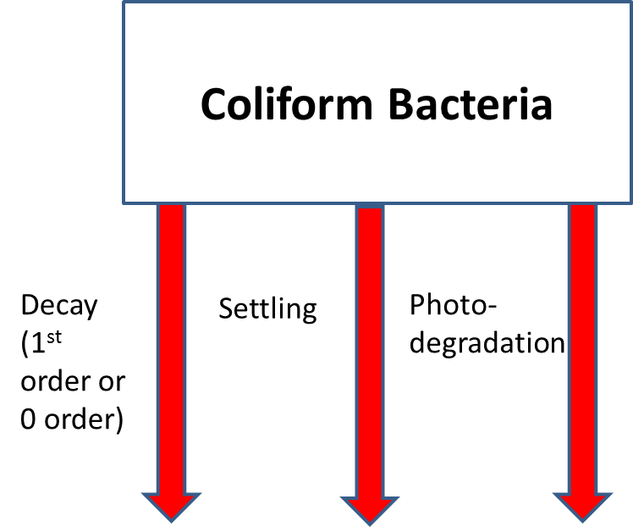
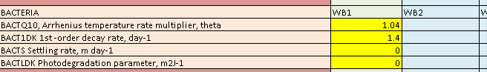
Water Quality: Bacteria

Slide 17
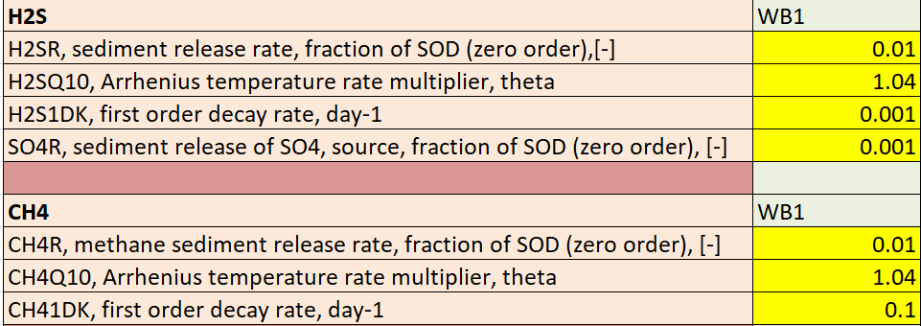
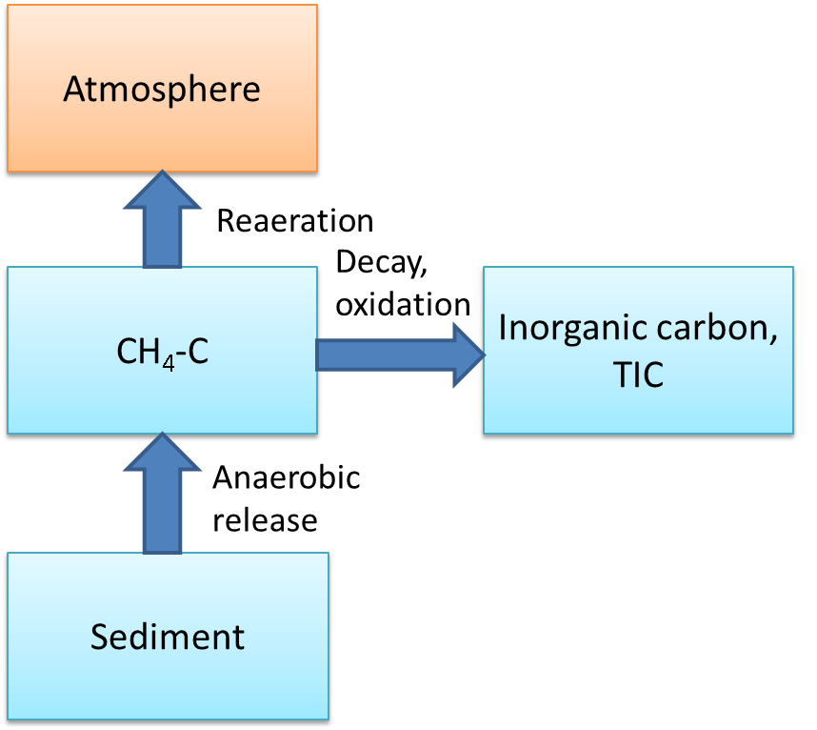
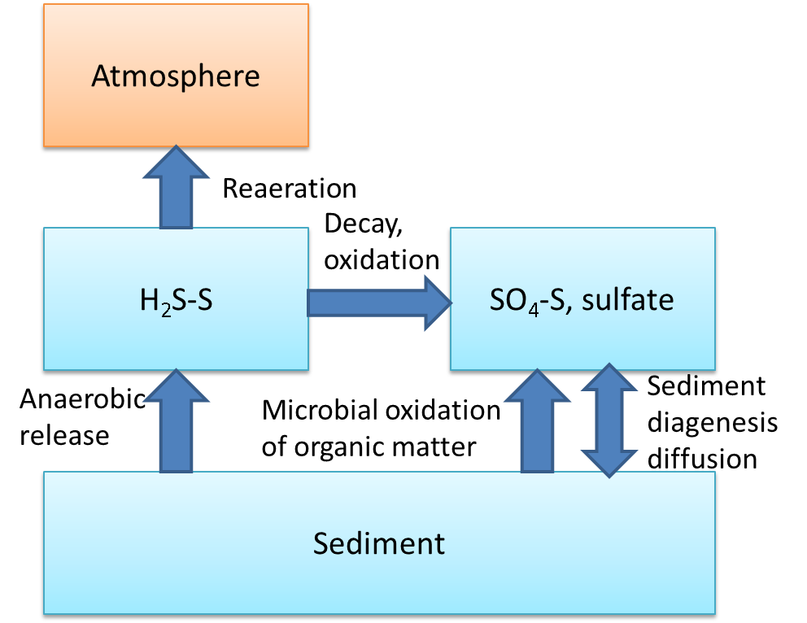
Water Quality: CH₄, H₂S

Slide 18
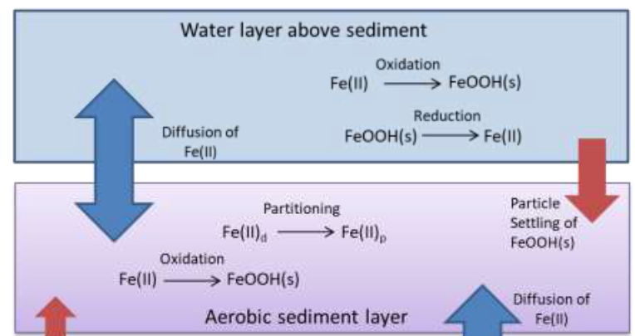
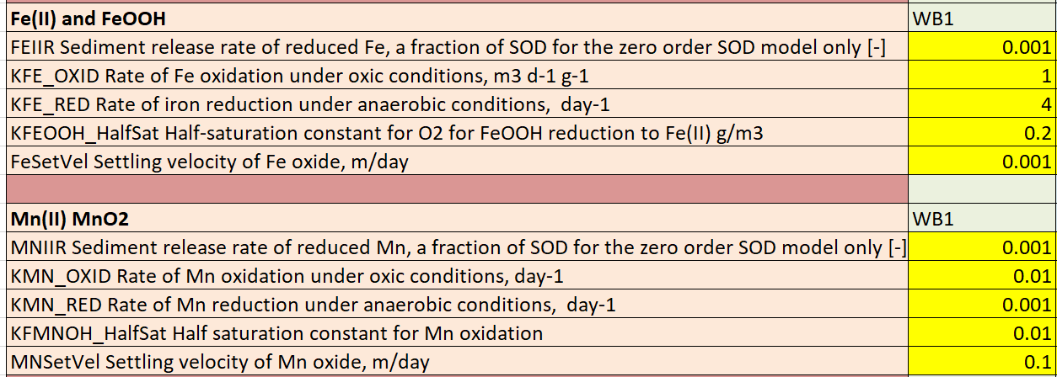
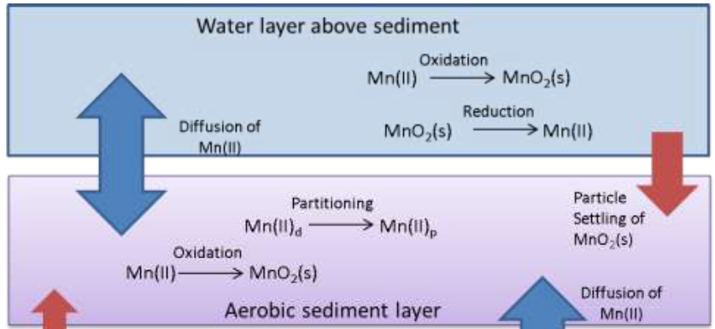
Water Quality: Fe(II), FeOOH, Mn(II), MnO₂
$$S_{MnII}=−K_{Mn}{Φ_{DO}θ}^{\left(PH−7\right)}Φ_{MnII}+K_{MnO2}\frac{K_{MnO2}}{K_{MnO2}+Φ_{DO}}Φ_{MnO2}+K_{sedrel}SOD\frac{A}{V}$$
$$S_{FeII}=−K_{Fe}{Φ_{DO}θ}^{\left(PH−7\right)}Φ_{FeII}+K_{FeOOH}\frac{K_{FeOOH}}{K_{FeOOH}+Φ_{DO}}Φ_{FeOOII}+K_{sedrel}SOD\frac{A}{V}$$

Slide 19
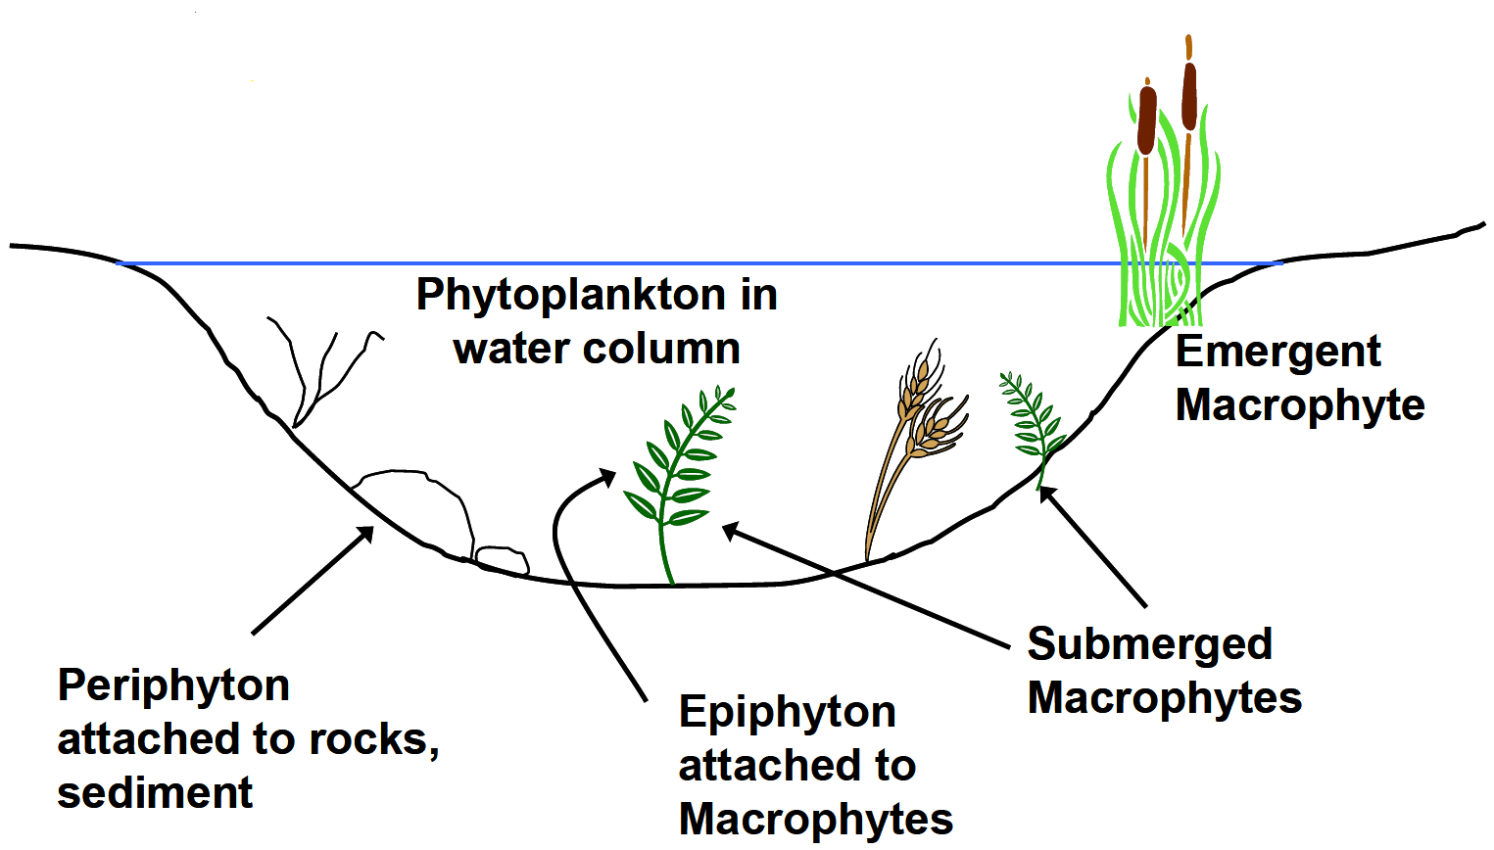
Water Quality: Organic Matter (OM) Constituents
N
7.2%
P
Labile Particulate Organic Matter
Refractory Particulate Organic Matter
Labile Dissolved Organic Matter
Refractory Dissolved Organic Matter
other
1%
51.8%
C
40%

Slide 20
Water Quality: Organic Carbon (OC) Constituents

Slide 21
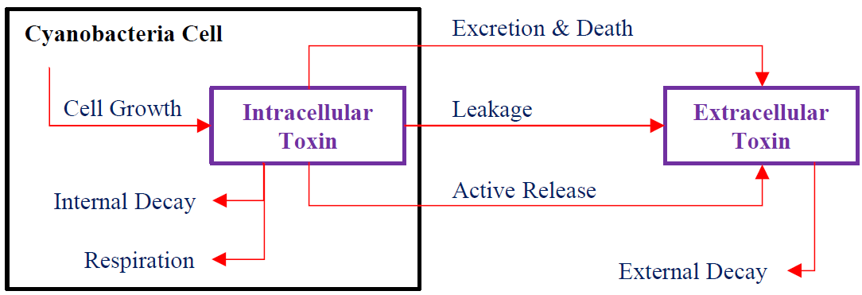
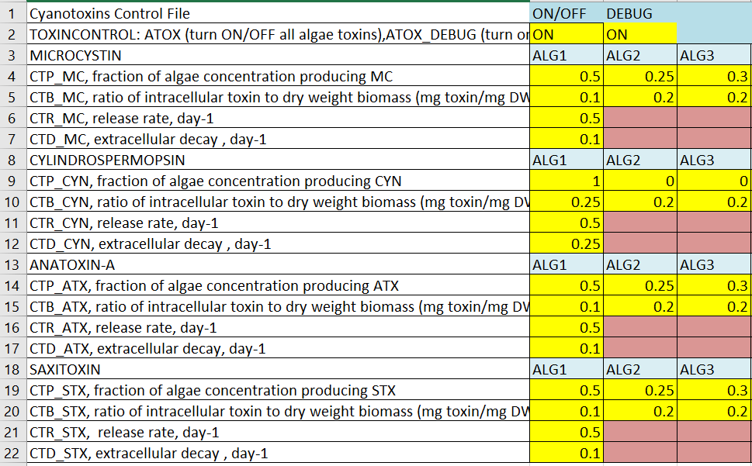
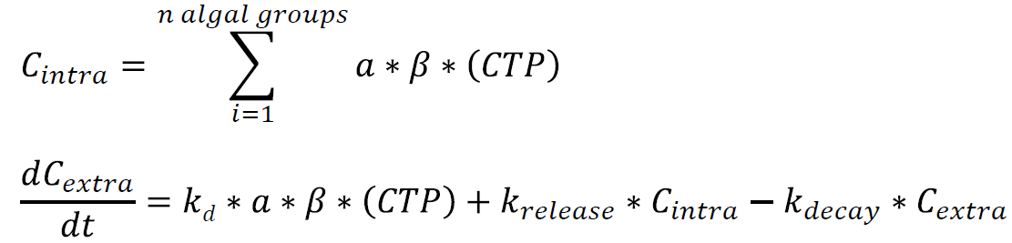
Water Quality: Algae Toxins
Four main toxins:
Microcystin – hepatotoxin
Cylindrospermopsin – cytotoxin
Anatoxin-a – neurotoxin
Saxitoxin – neurotoxin
CTP = fraction of algal group producing toxin
β = ratio of intra. toxin mass to mass of dry weight OM

Slide 22
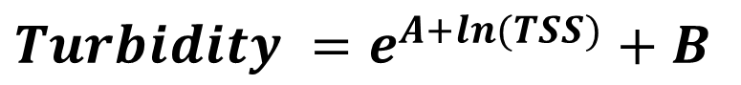
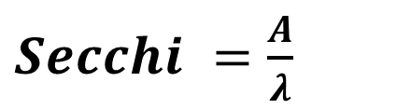
Water Quality: Derived Variables
Turbidity (NTU) is computed from a correlation to TSS (Total Suspended Solids)
$$Turbidity =e^{A+ln(TSS)}+B$$
Secchi disk (m) is computed from $λ$(light extinction coefficient)
$Secchi =$ $\frac{A}{λ}$

Slide 23
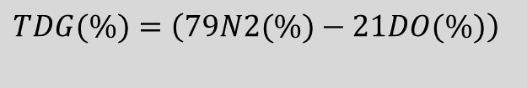
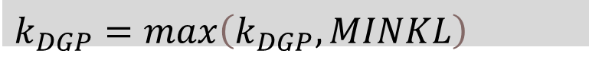
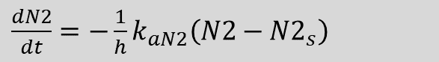
Total Dissolved Gas (TDG)
Modeling N2 and DO
$\frac{dN2}{dt}=−\frac{1}{h}k_{aN2}\left(N2−{N2}_{s}\right)$
$TDG(\%)=\left(79N2(\%)−21DO(\%)\right)$
Lake/reservoir
Modeling DGP (Dissolved Gas Pressure)
$\frac{dDGP}{dt}=−k_{DGP}\left(DGP−{PALT}_{atm}\right)$
$$k_{DGP}=max\left(k_{DGP}, MINKL\right)$$
Amount of gas absorbed by water is proportional to its partial pressure in the atmosphere (conc. = solubility factor X partial pressure)
Stream/River

Slide 24
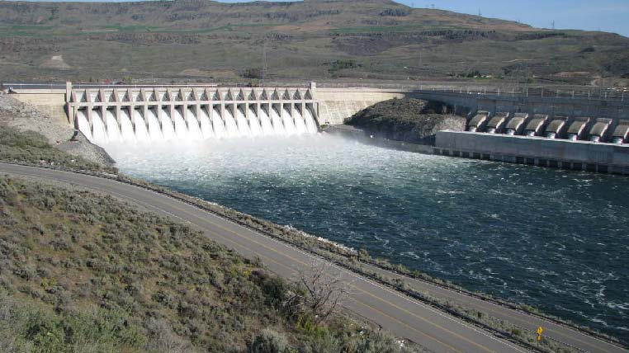
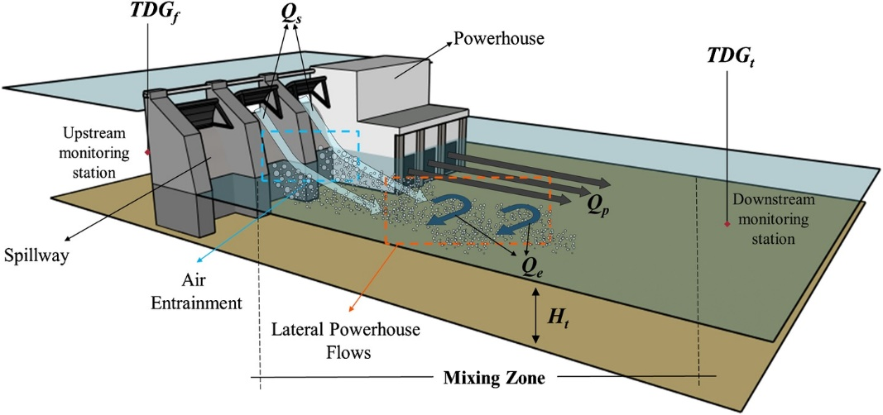
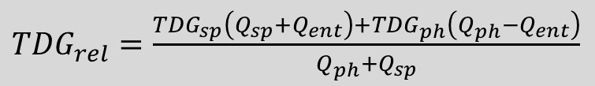
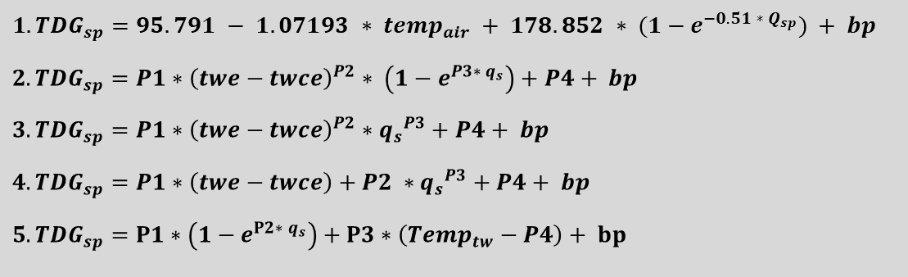
Total Dissolved Gas (TDG)/SYSTDG
Dam Effects on Oxygen/Gas Transfer
Spillways, Weirs, and Gates
SYSTDG is an Excel-based spreadsheet model used to compute TDG saturation levels in reservoir and riverine systems.
TDG production equations:
${1. TDG}_{sp}=95.791 − 1.07193 ∗ {temp}_{air} + 178.852 ∗ (1−e^{−0.51 ∗ Q_{sp}}) + bp$
$${2. TDG}_{sp}=P1∗{\left(twe−twce\right)}^{P2}∗ \left(1−e^{P3∗ q_{s}}\right)+P4+ bp$$
$${3. TDG}_{sp}=P1∗{\left(twe−twce\right)}^{P2}∗{q_{s}}^{P3}+P4+ bp$$
$${4. TDG}_{sp}=P1∗\left(twe−twce\right)+P2 ∗{q_{s}}^{P3}+P4+ bp$$
$${5. TDG}_{sp}=P1∗\left(1−e^{P2∗ q_{s}}\right)+P3∗\left({Temp}_{tw}−P4\right)+ bp$$
${TDG}_{rel}=\frac{{TDG}_{sp}\left(Q_{sp}+Q_{ent}\right)+{TDG}_{ph}\left(Q_{ph}−Q_{ent}\right)}{Q_{ph}+Q_{sp}}$

Slide 25

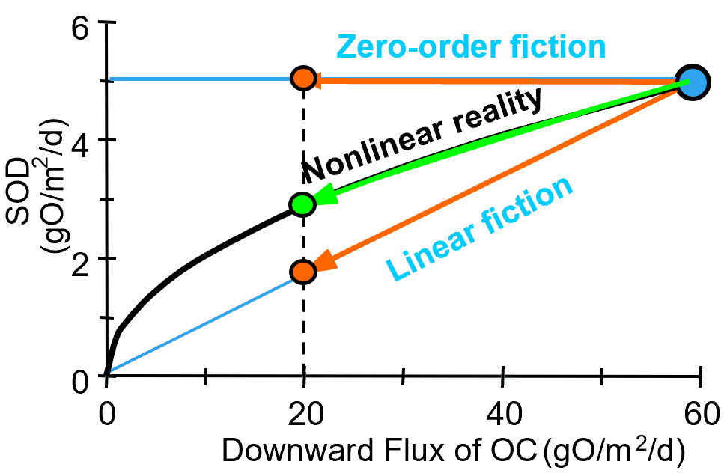
Sediment Compartment
Area
Surface cell
Zero order sediment fluxes
Directly specify nutrient releases, with temperature adjustment
Available in almost all water quality models
First order sediment fluxes
Link fluxes to organic matter
Limited application
Sediment diagenesis modeling
Directly simulate the reactions in the sediment layer
Water Column
Bottom cell
Active Sediment Layer
Deep Sediments
Courtesy of Steven Chapra

Slide 26
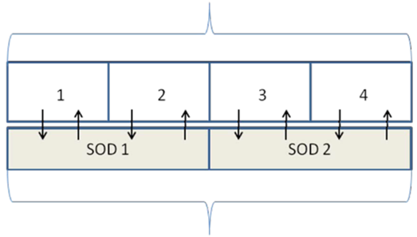
Sediment Diagenesis
Inputs: csv format
Outputs: Bottom layer and averaged outputs
Improve the computations
Add SOD and sediment fluxes for all water column layers
Add initial conditions for NO3 in sediment layers
Add sediment POM (POC, PON and POP) computation
Add the correction for calculating SD_W12
Add a correction for PO4 partitioning coefficient in layer 1
Add partitioning of sediment NH4
Modify the numerical solution for CH4
Model layer

Slide 27
Sediment Diagenesis: State Variables and Processes
Organic matter (OM) accumulates on the bottom of water bodies
Accumulated OM reactions in bottom sediment layer
Aerobic reactions - fast
Anaerobic reactions – slow
Sediment fluxes
Any dissolved materials may move between water and sediment pore water
DO from water to sediment → SOD
Mass flux depends on concentration gradient

Slide 28
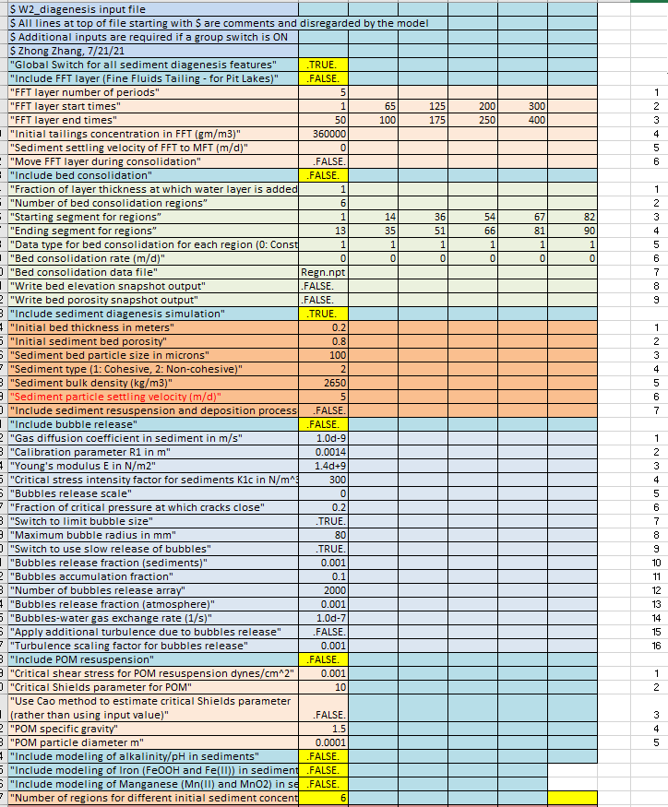
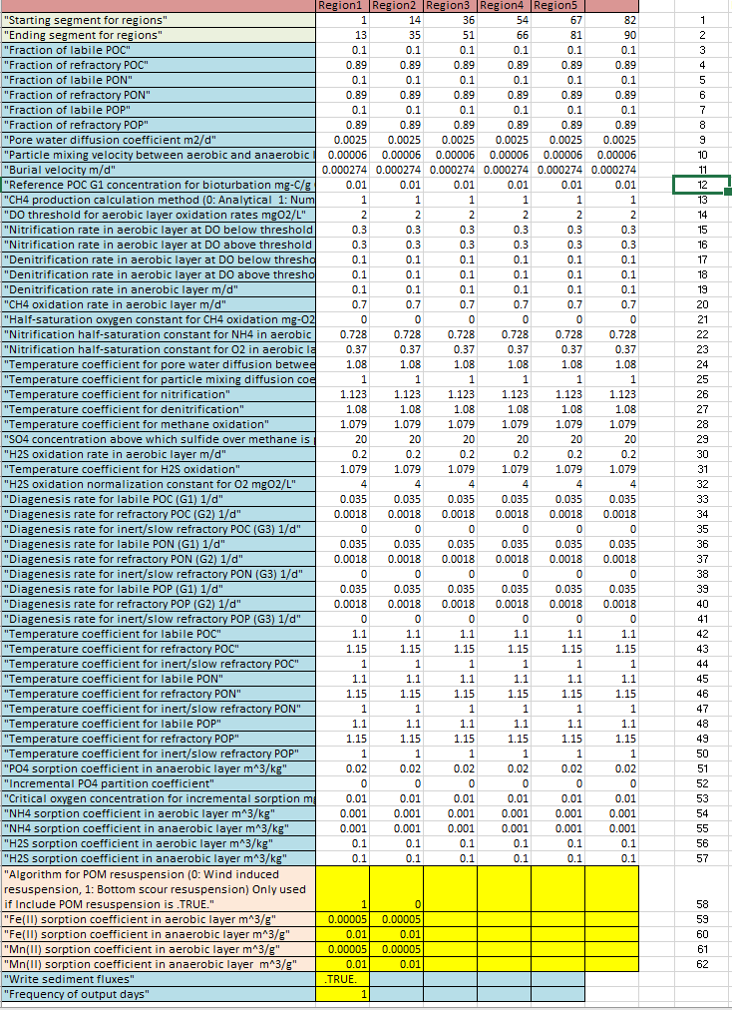
Sediment Diagenesis: Parameters and Calibration
Complex, uncertainty in sediment diagenesis parameter values which are often expensive to obtain and are heterogeneous, can lead to longer simulation times
Seems like a lot of parameters
What do we calibrate?
Net settling rates
Burial rates
Particle splits (G1, G2, G3)
Phosphate partition coefficients.
References
Di Toro, D.M. 2000. Sediment Diagenesis Modeling. New York, John-Wiley.
http://www.gonzo.cbl.umces.edu/index.htm

Slide 29
CE-QUAL-W2 Multi-Water Body Computation
Multiple waterbody simulation on multiple processors and preserving numerical precision improvements from 30-90%

Slide 30
CE-QUAL-W2 V4.5 Tools
w2_con.xlsm – develops W2 control files
w2_v45_64.exe – reads W2 inputs and execute the model
preW2-v45_64.exe – checks all W2 input files including the control file, bathymetry file, and all boundary condition files
WaterBalanceConsole_45.exe – performs the water balance calculation
W2_Post.exe – visualizes W2 model outputs
ConverterControlFile.exe – converts a previous version (V3.7 – V4.22) W2 control files into V4.5

Slide 31

Questions?

